Slide 1
It’s Town Hall time!

Slide 2
Text your question or issue to 480.748.5648
(Monica)

Slide 3
Cubic Feet
A gallon (or GGE) of CNG as ”a quantity of compressed natural gas equal to 126.67 cubic feet of natural gas at 60 degrees Fahrenheit and one atmosphere of pressure. In the alternative, it means a quantity of compressed
natural gas that weighs
5.66 pounds.” (Article II, R222).

Slide 4
However, The National Council of Weights and Measures no longer recognizes the cubic feet measurement of CNG, but does agree with the IFTA Agreement for the 5.66 lb. equivalent as a GGE of CNG. The US Dept. of Energy’s Alternative Fuels Data Center (https://afdc.energy.gov/fuels/equivalency_methodology.html ) lists the cubic feet measurement as 123.57 cubic feet of CNG as a GGE (it also has the 5.66 lbs. of CNG as a GGE).

Slide 5
IFTA’s definition of a GGE for CNG by cubic feet in the agreement no longer agrees with what is accepted by other reliable national sources, which creates an issue for jurisdictions that are required to follow IFTA rules. The agreement should either change and agree with other recognized sources or drop the cubic feet equivalent altogether and keep the 5.66 lbs. measurement.

Slide 6
Thoughts???

Slide 7
Surcharge
Pluses and minuses of having a Surcharge

Slide 8
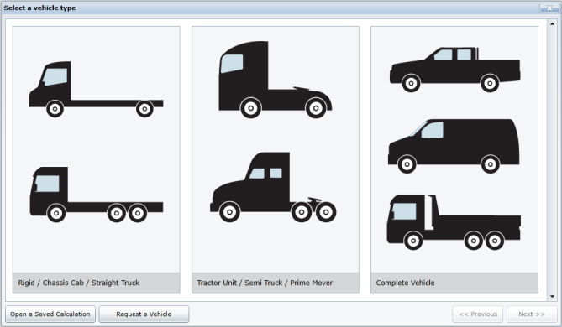
Vehicle List
How many jurisdictions require your carriers to provide a list of their vehicles?
Original License
Renewal

Slide 9
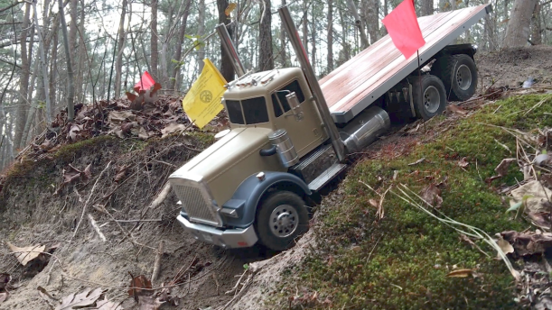
Off Road Miles
How do jurisdictions that allow exemptions for off road miles, verify reported off road miles?
Is there a certain threshold where verification is requested or do you request documentation to validate these miles?

Slide 10
Mileage Tax
With a change to the Agreement, could a per mile tax be collected through the IFTA Clearinghouse, much as a surcharge is collected now? It would be a
surcharge applied to
jurisdictional miles.

Slide 11
Exempt Distance and/or Fuel
There are member jurisdictions who have return filing systems that require the sum of taxable distance to equal the sum of total distance. The same is true of the sum of tax paid fuel equaling the sum of total fuel. If the licensee or the service provider/tax practitioner attempts to file a return where the taxable distance in a jurisdiction do not equal total distance, the return will not validate or post.
This is more prevalent in online filing systems; paper returns can be filed properly, it is not known whether a properly filed paper return will validate and post when the columns do not match. The problem is that many jurisdictions mandate electronic (online) filing and no longer support or offer paper returns.

Slide 12
DISCUSSION
The IFTA Articles of Agreement (R130.100.010) makes clear a jurisdiction's sovereign right to establish tax rates, exemptions, and exercise other substantive taxing authority. Article R830 sets forth the requirements regarding the reporting of exempt distance and/or fuel.
Section P720.500.020 establishes a requirement to have a separate column (or field) for taxable distance on the return. There are numerous exemptions permitted by member jurisdictions.

Slide 13
These may be distance exemptions (e.g. non-taxable miles in Oregon, travel on the Massachusetts Turnpike, various logging or mining roads), vehicle exemptions (e.g. school buses, certain passenger buses, cranes, well drillers, vehicles operated under a US Postal contract), or fuel exemptions. An IFTA licensee has the right to take these exemptions on the return. If the base jurisdiction cannot process and therefore does not honor the exemptions to which the licensee is entitled, how does the licensee file a true and correct return and therefore pay the correct taxes to all affected jurisdictions?

Slide 14
QUESTIONS
We would like to pose the following questions:
? How many jurisdictions have online tax return platforms that do not permit taxable distance to differ from total distance or tax paid fuel to differ from total fuel?
? Does your jurisdiction still support paper returns and if so will a return validate if the columns do not match?
? How is a licensee supposed to take a lawful exemption in Jurisdiction A when the base jurisdiction (Jurisdiction B) does not have a return that permits it?

Slide 15
Electronic Verification of Credentials
What are jurisdictions doing to prepare for electronic verification of credentials? Such as legislation (if necessary), discussions with law enforcements on what is needed for roadside enforcement, system upgrades, other use of technology, etc.
a. How soon do you anticipate your jurisdiction will be ready to validate all credentials electronically?
b. What obstacles do you anticipate your jurisdiction having?
c. How can IFTA/IRP help your jurisdiction move in this direction?

Slide 16
VMT
Is your jurisdiction doing any type of VMT study, pilot program, or information gathering?
If so, can you share what you are doing and how it affects the commercial vehicle realm?

Slide 17
Ballot Voting
Full Track – Short Track – NEW Track
It’s time to take a look at the processes.
When to Vote – How to vote
What would you like to see changed in the current processes?

Slide 18
Questions about IFTA, Inc.
How will Operational Goals and the progress toward meeting those goals be communicated to membership?
What is the status of remote workforce/office rental decision?

